Slide 1




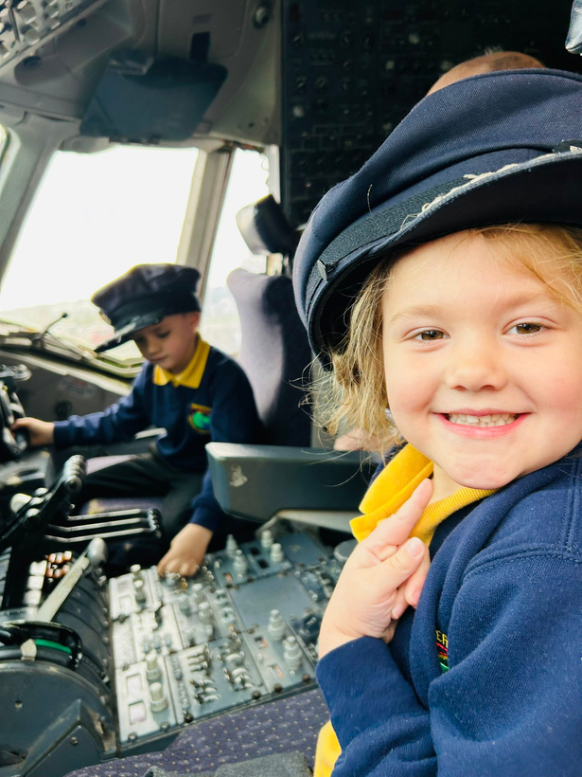

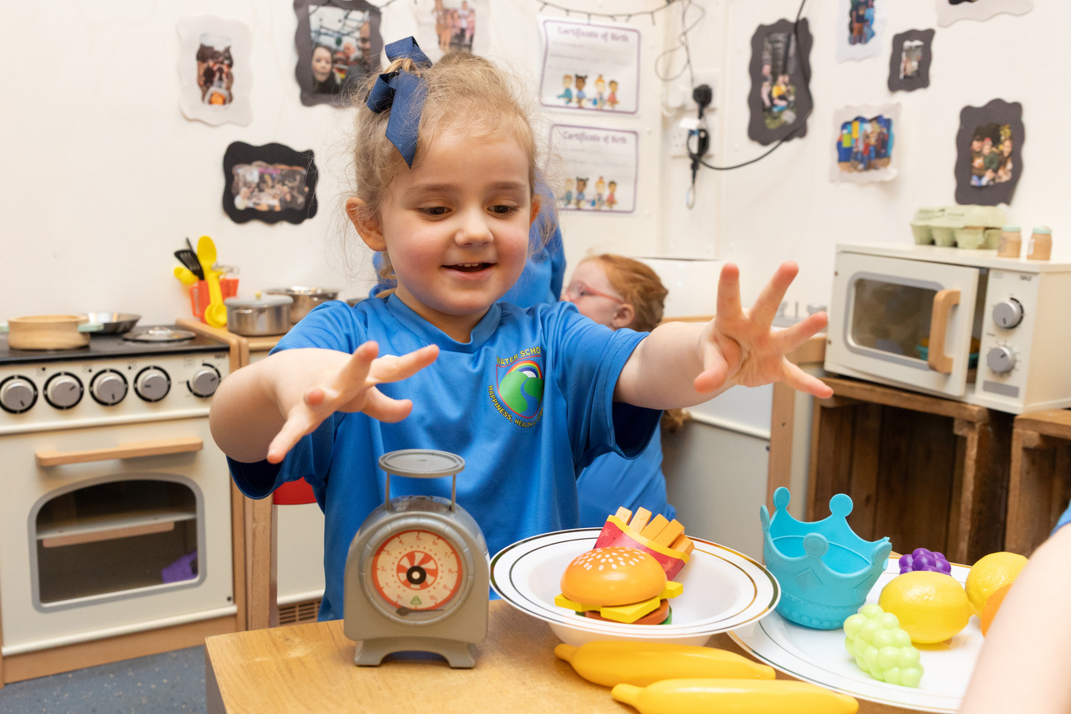


)
)
)
ACORN CLASS
)
)
)
)
)
)
)
)
Water Primary, a small school with a big heart.
In our Water family, we encourage passionate curiosity and a deeper understanding of the world around us in an environment where everyone is valued, empowered and achieves their full potential.
)
)
)
)
)
)
)

Slide 2


)
)
)
)
)
)
)
)
)
)
)
)
)
)
)
)
)
)

Slide 3
)
)
ACORN CLASS
)
)
🌿 About Acorn Class
  Acorn Class includes a mix of Reception and Year 1 children.
  While this might seem a little different, it offers many wonderful benefits for your child’s learning and development.
🤝 Learning Together
  Children learn alongside one another, helping to build confidence, friendships, and social skills.
  Younger children benefit from watching and learning from the older pupils.
  Older children enjoy taking on a supportive role, which helps deepen their own understanding.
  This shared experience creates a positive and collaborative classroom environment.
)
)
)
)
)
)
)
)
)
)
)
)
)
)

Slide 4
)
)
ACORN CLASS
)
)
👩‍🏫 Support for Your Child
  The class is led by Mrs Smith, supported by dedicated teaching assistants.
  We make sure every child is supported, challenged, and encouraged at their own level.
  Our team is always there to help children feel happy, safe, and confident in school.
💛 A Nurturing Environment
  Acorn Class is a caring and supportive space where children can thrive.
  We encourage:
    Confidence and independence
    A love of learning
    Curiosity and creativity
)
)
)
)
)
)
)
)
)
)
)
)
)
)

Slide 5
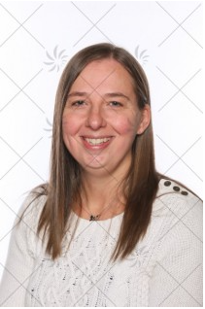
)
)
I will be your class teacher.
I can’t wait until September when we can do lots of learning and playing together.
Here are some facts about me;
• I have 2 little girls called Willow and Emilia.
• My favourite children’s programme is Bluey.
• My favourite books are by Julia Donaldson, especially ‘What The Ladybird Heard’.
• My favourite subject at school is art.
• My favourite colour is purple.
• My favourite foods are pizza and pasta.
• I love to go on my paddle board at the weekend.
ACORN CLASS
)
)
)
)
)
)
)
)
)
)
)
)
Mrs Smith
Class Teacher
)
)
)
)

Slide 6
)
)
)
)
)
)
)
Starting School
School starts on the 2nd September. Children in Reception will be attending full days from the start. The class teachers will spend the first couple of weeks getting to know your children and helping them get used to the routines of school.
Doors open at 8:45 a.m. Please bring your children to the gate outside the classroom.
Reporting to Parents
Formal parents meetings will take place in the autumn and spring term where your child’s friendships, interests, behaviour, progress and next steps in learning are shared.
At the end of the academic year, each child will receive a written report. Parents are welcome to view children’s learning journey’s anytime throughout the year.
)
)
)
)
)
)
)
)
)
)
)

Slide 7
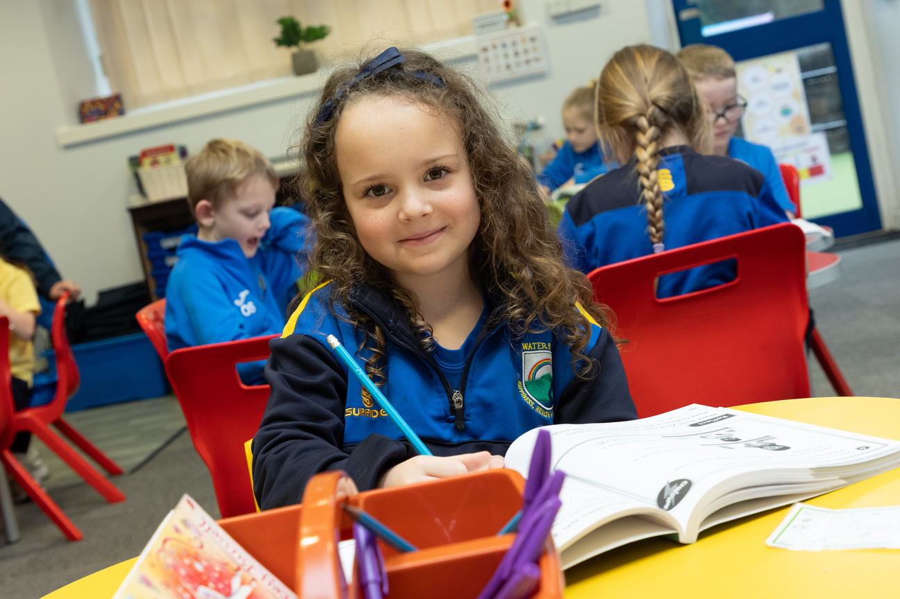
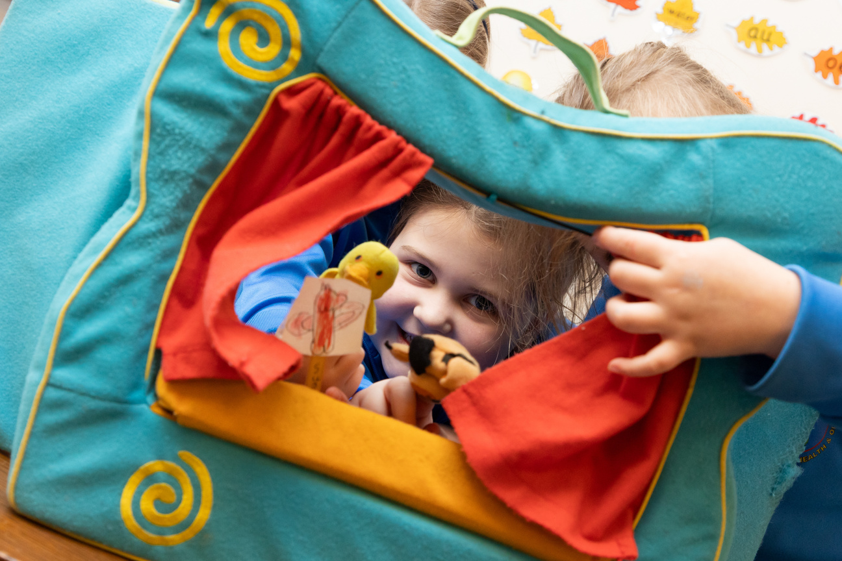
)
)
)
)
)
)
A TYPICAL SCHOOL DAY
8:45 - MORNING TASK
8:55 - REGISTRATION
9:00 - PHONICS
9:30 - MATHS FOCUS/PROVISION
10:15 - PLAYTIME
10:30 - ASSEMBLY
10:45 - MATHS CONTINUED
11:00 - ENGLISH FOCUS/PROVISION
12:15 - DINNERTIME
1:15 - AFTERNOON PROVISION/SESSIONS
3:10 - STORY
3:25 - END OF DAY
)
)
)
)
)
)
)
)
)
)
)
)

Slide 8
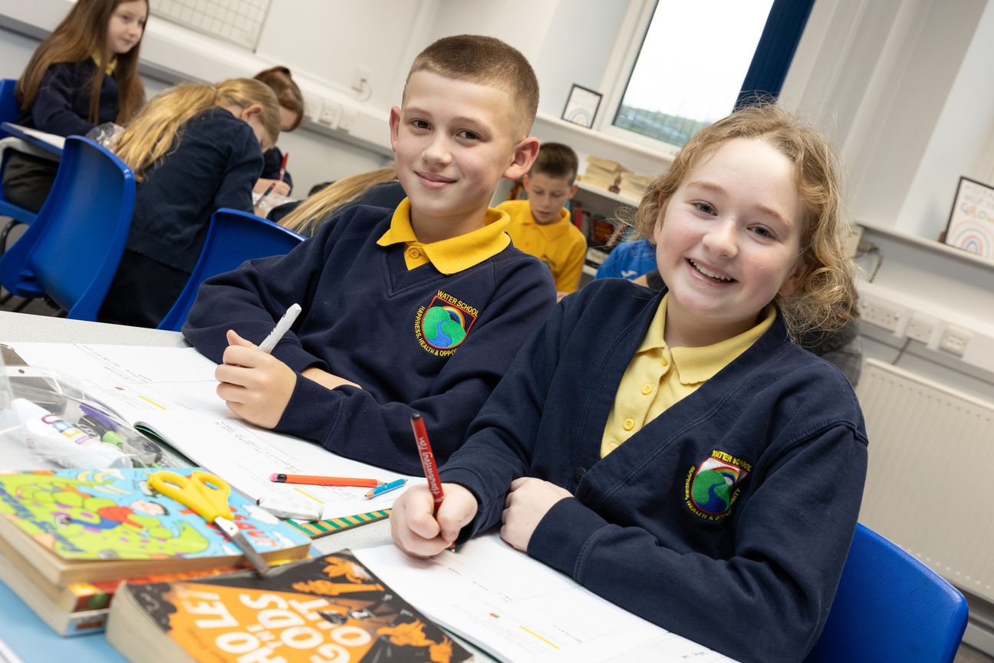
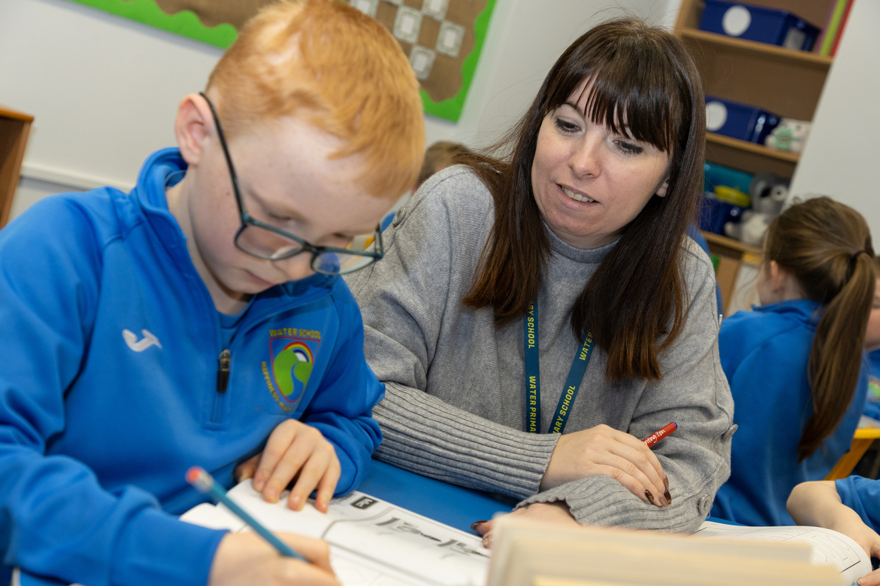
)
)
)
)
)
)
)
OUR EYFS CURRICULUM
)
)
At Water Primary School, our unique EYFS curriculum is designed around the interests and needs of our children. We provide a language-rich environment and focus on high-quality interactions through both continuous provision and carefully planned adult-led activities. Children are encouraged to take an active role in their own learning, supported by well-resourced areas and thoughtful enhancements that develop their skills and knowledge.
)
)
)
)
)
)
)
)
)

Slide 9
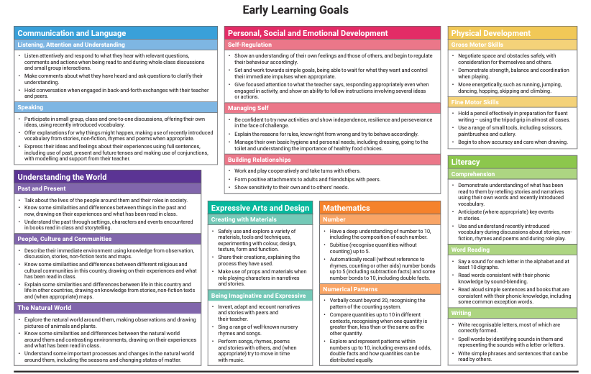
)
)
)
)
)
)
)
)
)
)
)
)
)
)
)
)
)
)

Slide 10

)
Teachers assess what each child knows and can do to decide their progress. At the end of Reception, children are given an outcome for each Early Learning Goal:
  Emerging – not yet at the expected level
  Expected – working at the expected level
These outcomes are shared with you in their end of year reports.
Please remember, there is no need to worry if your child is given an emerging level for one or more of the goals. Children develop at different rates and the main purpose of the profile is to provide support for each child at the correct level as they continue through the school.
)
)
)
)
)
)
)
)
)
)
)
This document is great at breaking down children’s milestones and also giving activities for parents to follow at home. You can find this and the Early Learning goals on our website under the EYFS page.
)
)
)
)
)
)

Slide 11
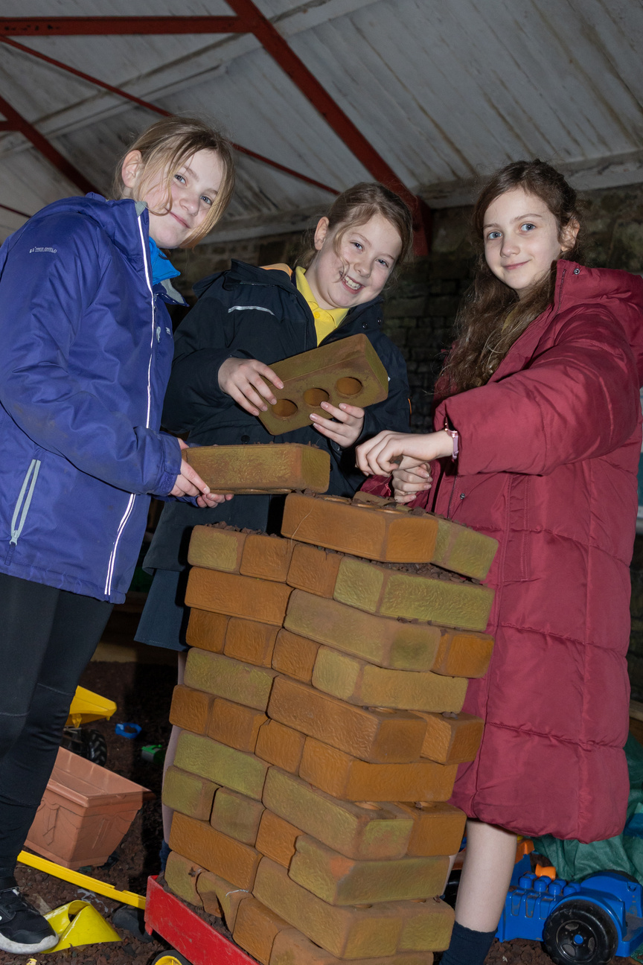
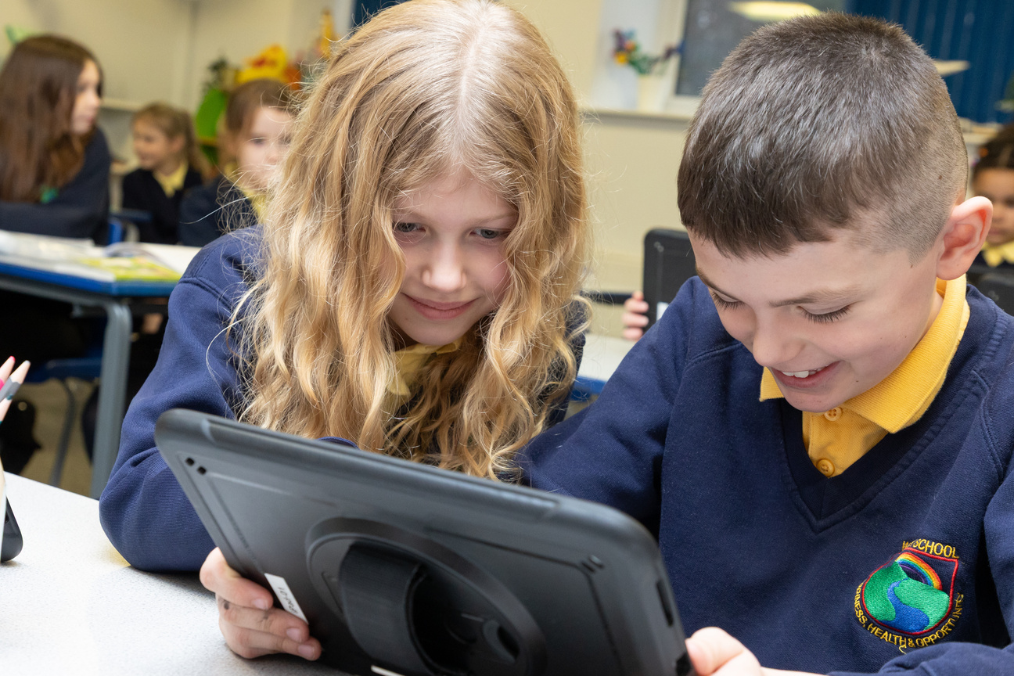
)
)
)
)
)
)
)
PHONICS AND READING
)
  We are a reading-focused school and encourage daily reading at home.
  Children receive a home reading book soon after starting.
  Early books may be picture-based to build confidence and discussion skills.
  Teachers check regularly that books match your child’s level.
  Please read together often and sign the reading record.
  Children also do guided reading in small groups to develop phonics and understanding.
)
)
)
)
)
)
)
)
)
)

Slide 12
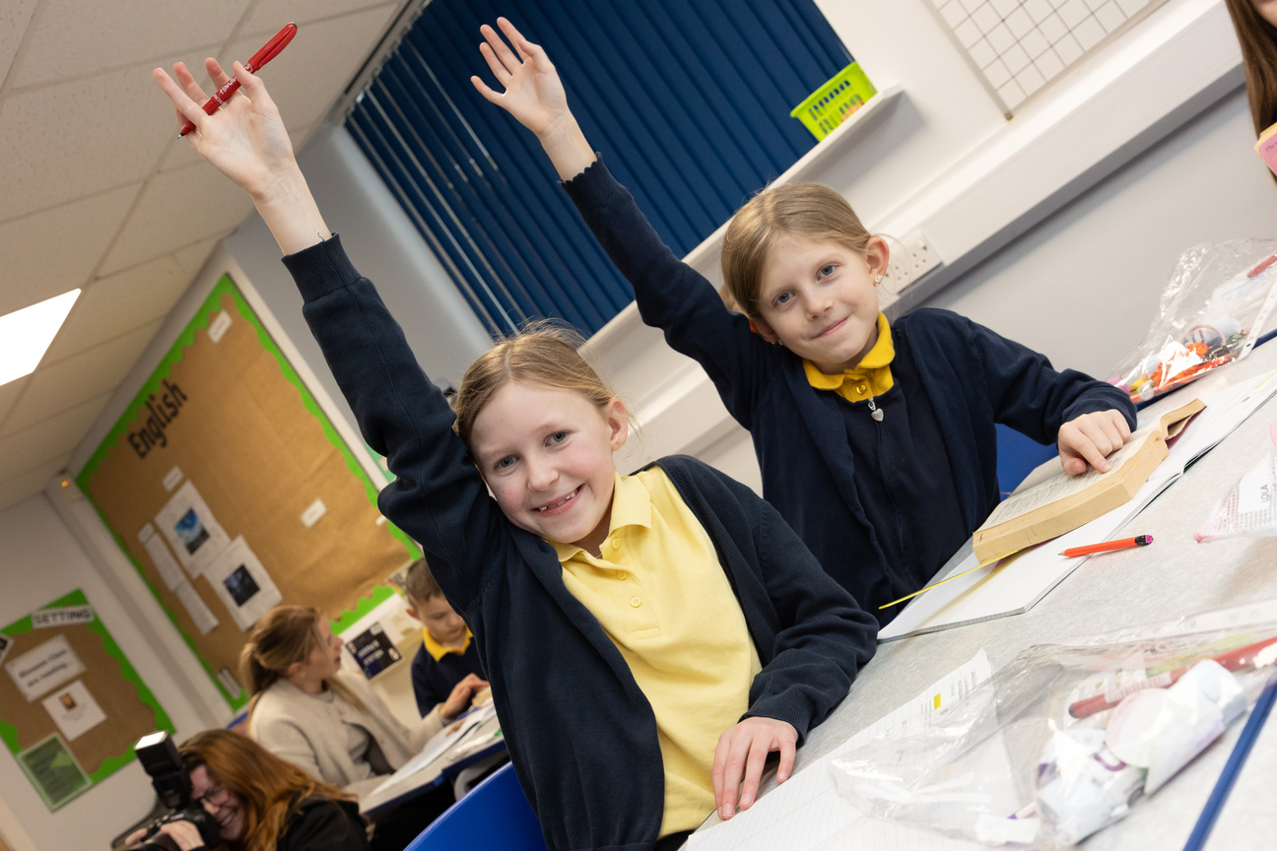
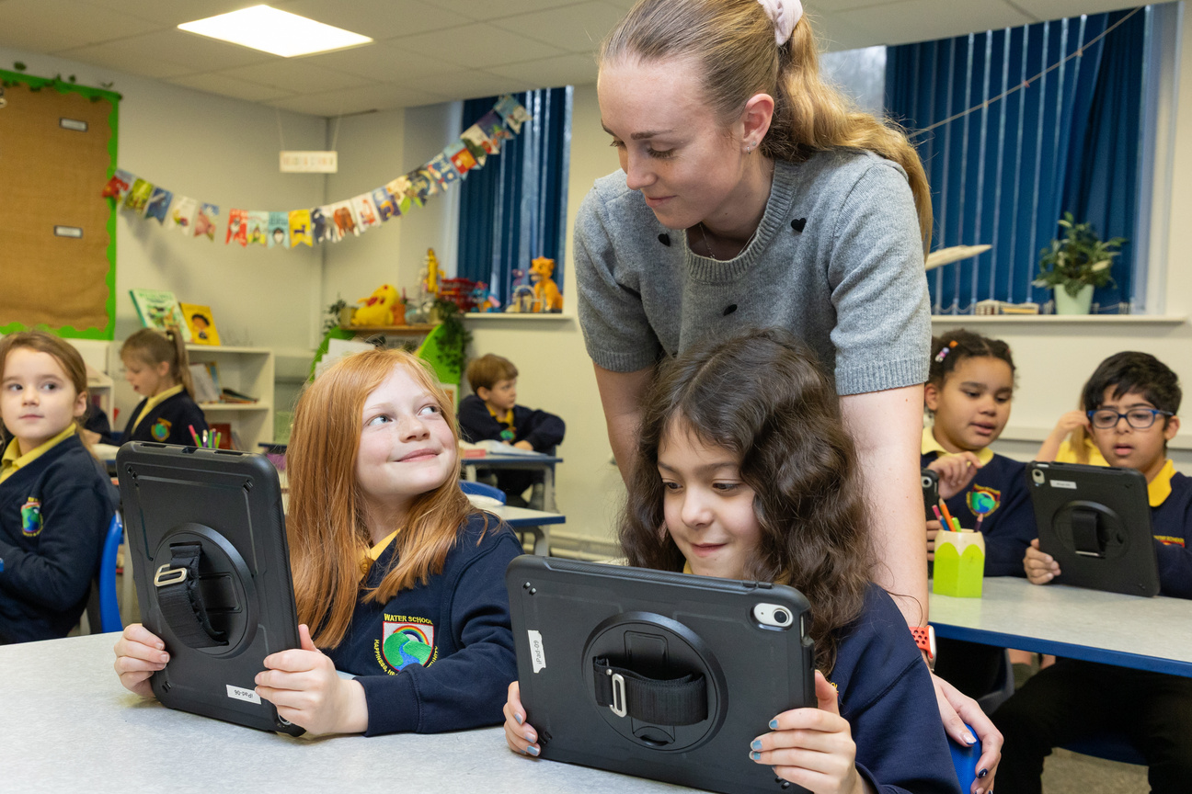
)
)
)
)
)
)
)
)
MATHS
)
)
We use the Power Maths scheme, which helps children develop a strong understanding of number through a mastery approach.
Learning is broken down into small, manageable steps to support all learners.
You can support your child at home by:
  Counting everyday objects
  Spotting and naming shapes
  Talking about numbers in the world around them
)
)
)
)
)
)
)
)

Slide 13
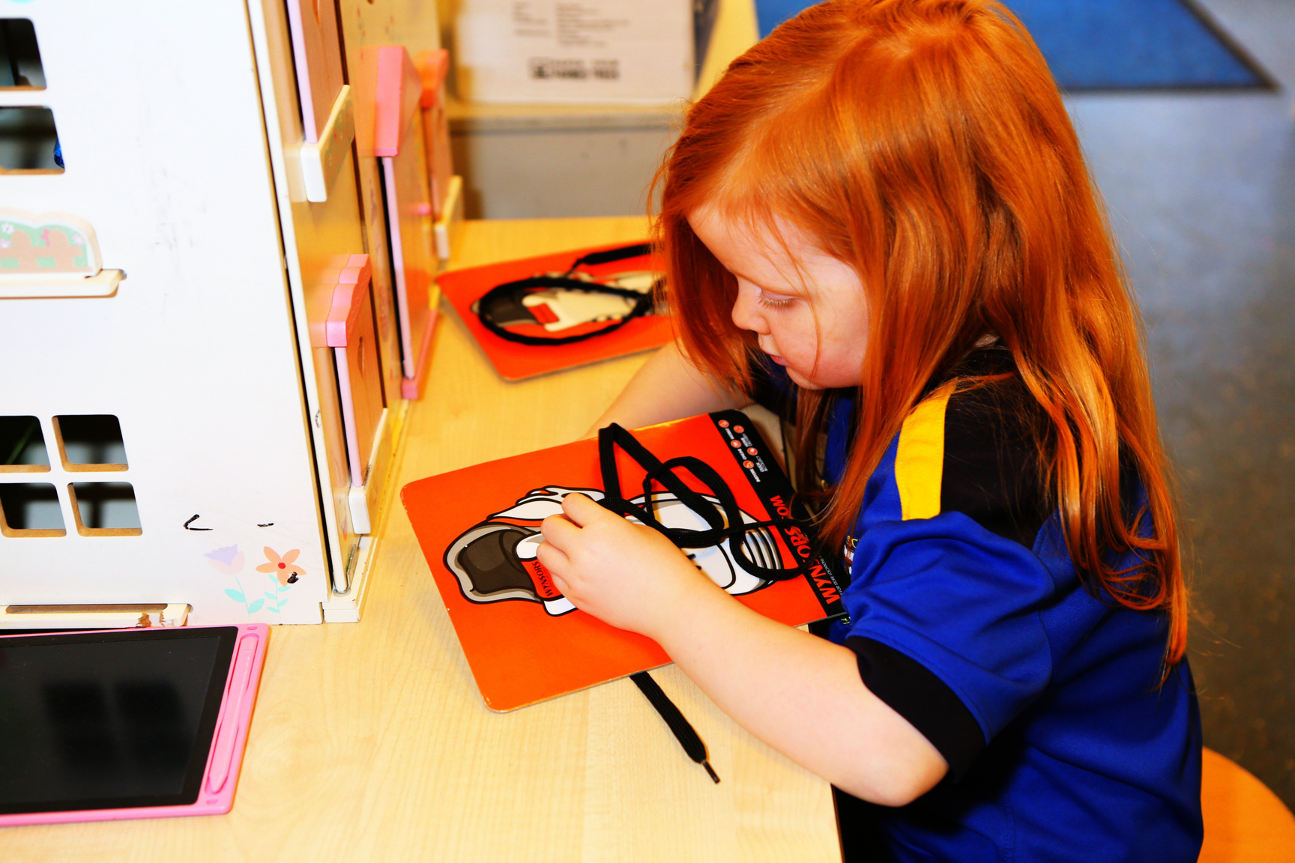
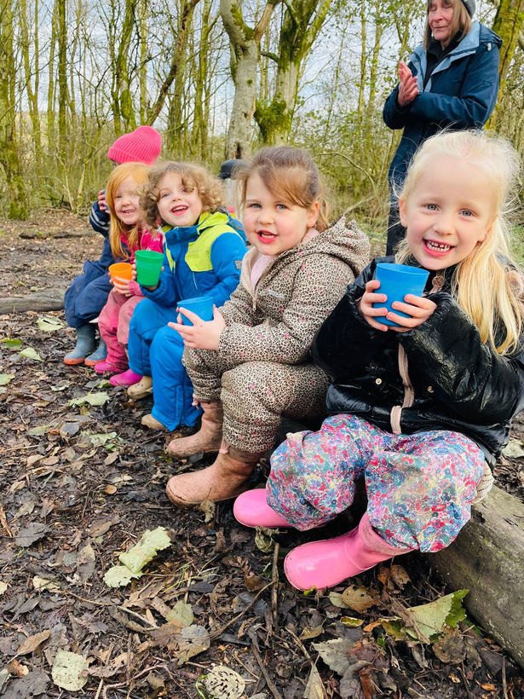
)
)
)
)
)
)
Continuous Provision and Learning
  In Acorn Class, we use a range of themes that often link to our wider school curriculum, such as celebrations, festivals, and events from the past.
  Each area of the classroom supports a different area of your child’s development. While some activities are guided by the teacher, we also encourage children to explore, investigate, and lead their own learning.
)
)
)
)
)
)
)
)
)
)
)
)

Slide 14
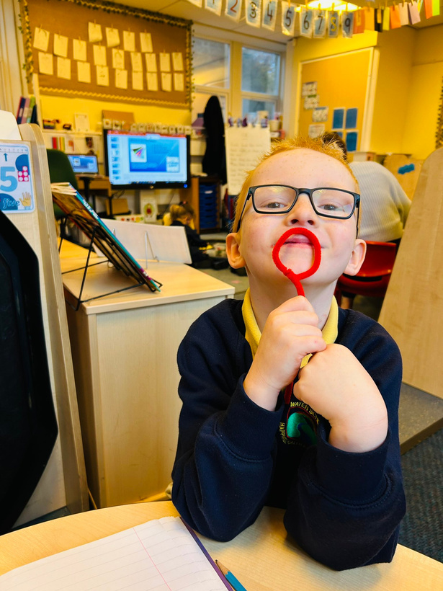
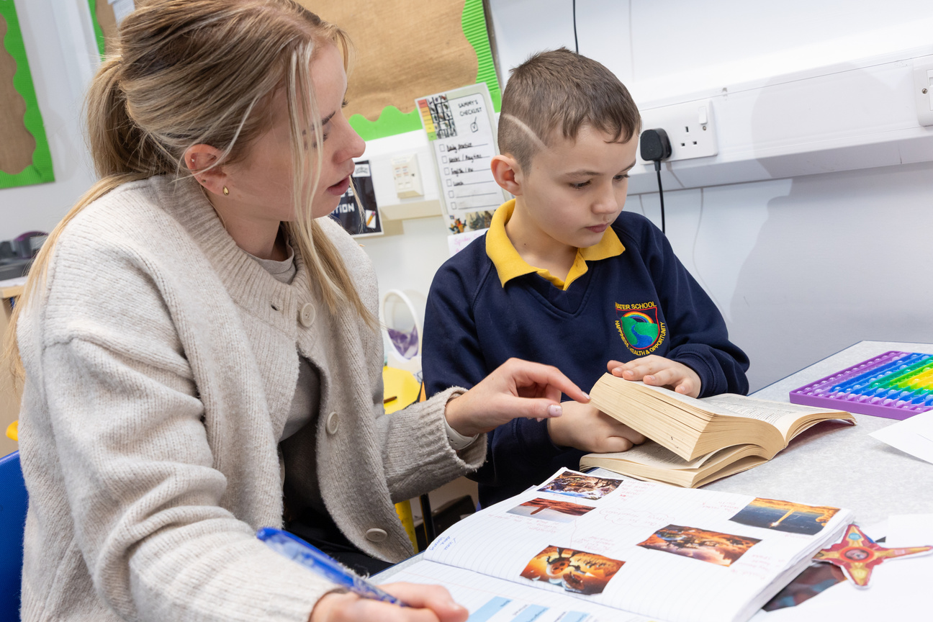
)
)
)
)
)
)
)
)
P.E.
)
)
Children at Water have a 2 hours of P.E. each week. we are strong advocates of promoting physical activity in our children.
P.E. days will be communicated to you before each half term. We ask that children come to school in their P.E. kits on the day of theri lesson.
)
)
)
)
)
)
)
)

Slide 15
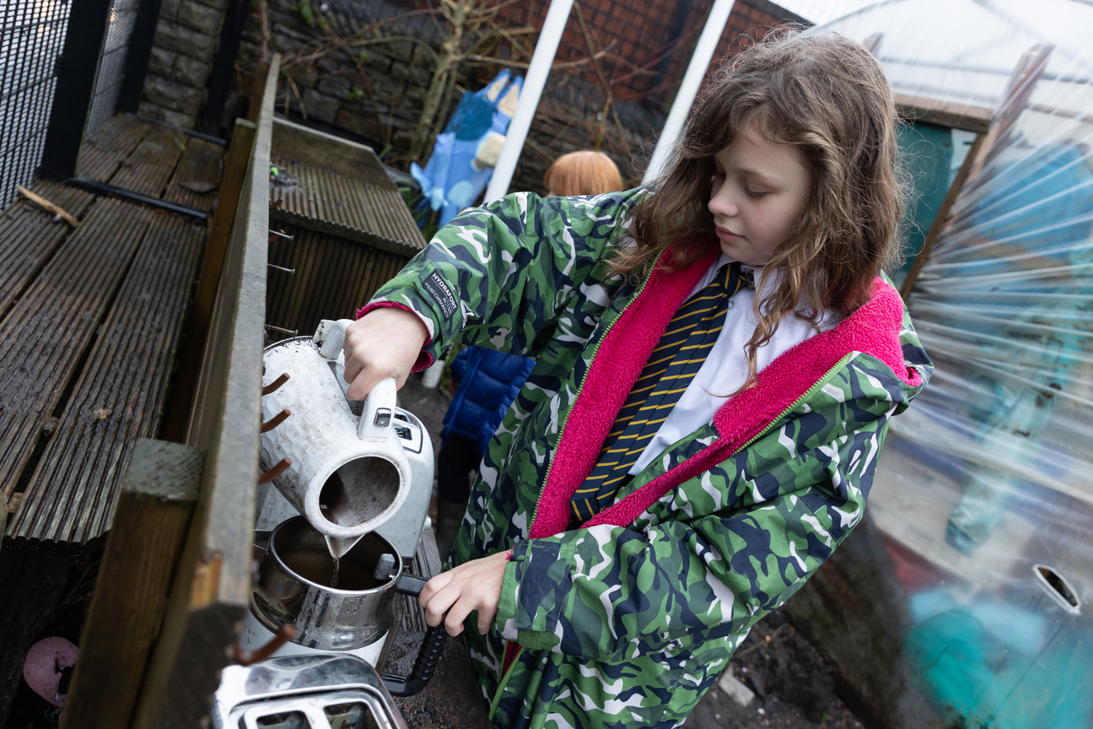
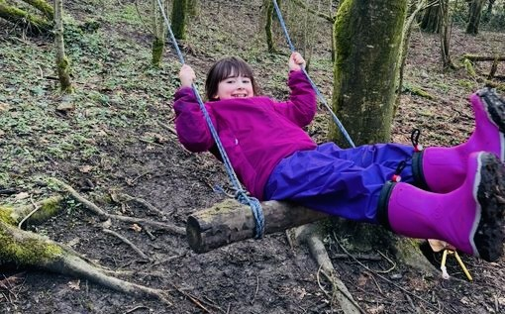
)
)
)
)
)
)
)
)
FOREST SCHOOL
)
)
  Our Reception children take part in Forest School for most of the year, usually beginning in Autumn Term 2.
  We ask that children come to school in their P.E. kits and bring suitable outdoor clothing for all weather conditions (and mud!).
)
)
)
)
)
)
)
)

Slide 16
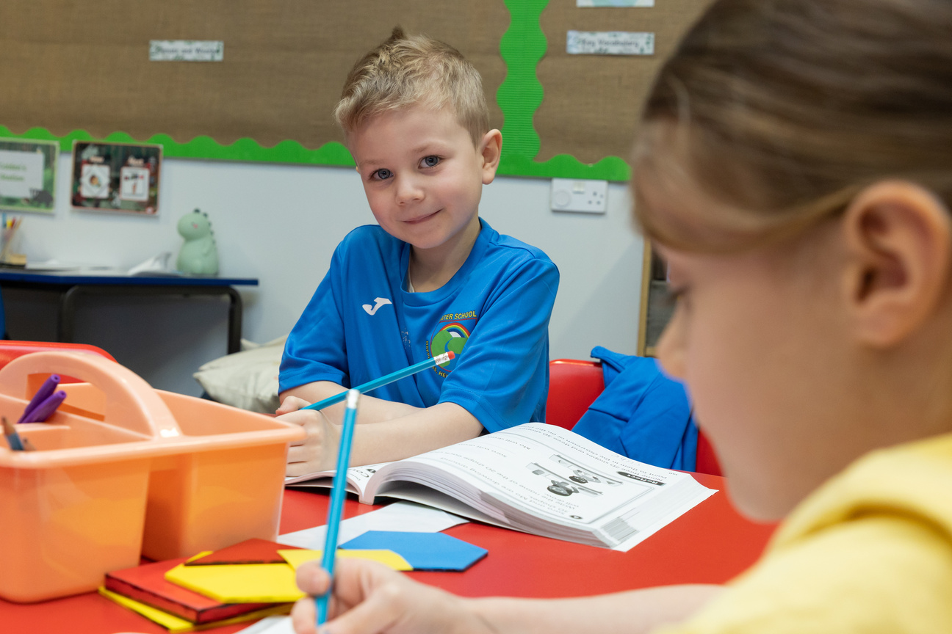
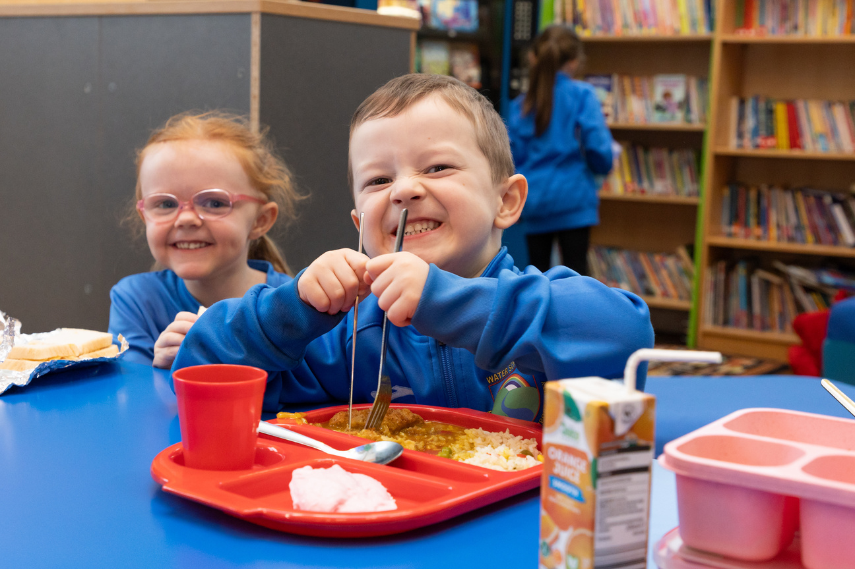
)
)
)
)
)
SOCIAL AND EMOTIONAL WELLBEING
)
)
)
We use a Mood Tracker app each morning and afternoon, where children can share how they are feeling.
This helps us to:
  Support children with strategies if they are feeling sad or worried
  Help manage feelings like anger or frustration
  Encourage children to share and celebrate positive feelings
  We also support children’s wellbeing through assemblies and PSHE lessons, helping them understand and manage their emotions.
)
)
)
)
)
)
)
)
)
)

Slide 17
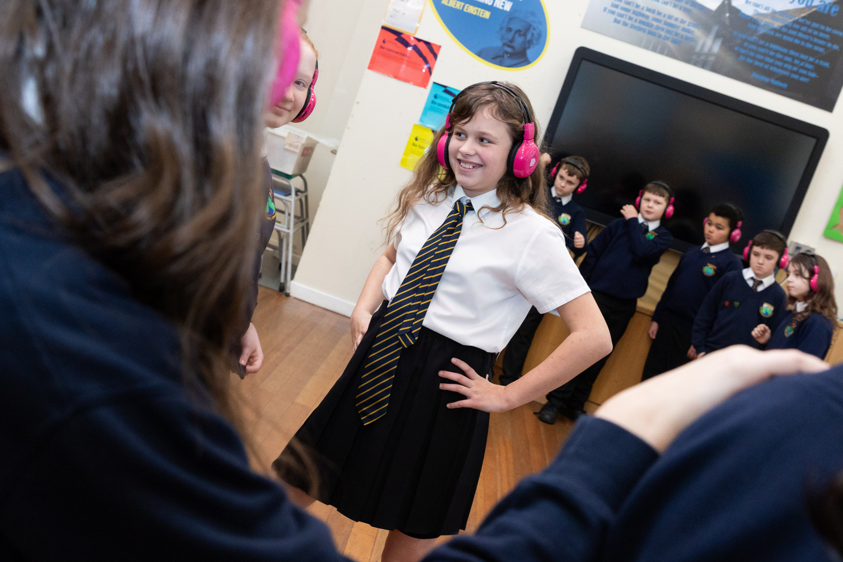
)
COMMUNICATION
)
)
)
  We aim to be as paperless as possible, so most information will be shared by text message and on our school website.
  Our weekly newsletter will keep you updated with important information, events, school meals, and highlights from each class.
  Class teachers update their class page each half term so you can see what your child is learning. You can also follow us on social media @waterprimary to see what’s happening in school.
  If you need to speak to a teacher, they are available at the start and end of the day for quick chats. For anything more, please contact the school office on 01706 216414 or email enquiries@water.lancs.sch.uk, and the right member of staff will get back to you.
)
)
)
)
)
)
)
)
)
)
)
)
)
)

Slide 18
)
ATTENDANCE
)
)
  Good attendance supports learning, friendships, and wellbeing.
  The school day starts promptly; late arrival can disrupt learning.
  Parents/carers must inform the school on the first day of absence (and each day).
  Any planned absence must be requested in advance in writing. Forms are available from the office.
  Taking holidays during term time may result in penalties (such as fines) under local authority rules.
  Schools typically aim for at least 95%+ attendance for every child.
  Contact details
  Ensure the school always has up-to-date contact information in case they need to reach you quickly.
)
)
)
)
)
)
)
)
)
)
)
)
)
)
)

Slide 19
)
)
Breakfast and After School Club
Our wrap around clubs are run by an outside agency named PALS. Please see the attached leaflet for further information on prices and booking.
School Clubs
As a school, we recognise the importance of the wider curriculum and school life. We provide clubs most terms from 3:25 p.m. to 4:25 p.m. These can vary from sports, arts and gardening! You will be notified of the clubs at the beginning of each half term and you will be able to book your child onto the clubs via Parent Pay.
Seeds and Gardeners
Water has a ‘Seeds and Gardeners’ project where your reception child (the seed) will be linked to one of our year 6 pupils (the gardeners). Gardeners will act as a buddy to their seed, helping them find their way around school. Seeds and gardeners will attend forest school together and see each other regularly. Our seeds and gardener project is always a great success and loved by all the children.
)
)
)
)
)
)
)
)
)
)
)
)
)
)
)
)

Slide 20
)
)
Parking
Parking around school can be tricky during busy times, we encourage families to walk from home if possible or if not, Lumb Baptist Church kindly let us use their car park.
Lunches/Snacks
All children in EYFS/KS1 are entitled to free school dinners. We ask you to book these on parent pay. We understand that some children may not like the lunches so you can also send your child in with a packed lunch. Each child gets free fruit each day and a water bottle. For £1 a week, we also have snack for our children.
)
)
)
)
)
)
)
)
)
)
)
Collecting and Dropping Off
Children should be dropped offf and collected at the entrance of the Acorn Classroom. Safeguarding is a priority for us at Water Primary School so we pleae ask tha you let us know if a new person may be collecting your child. We will ask you to create a password which must be shared with staff when collecting your child.
)
)
)
)
)

Slide 21
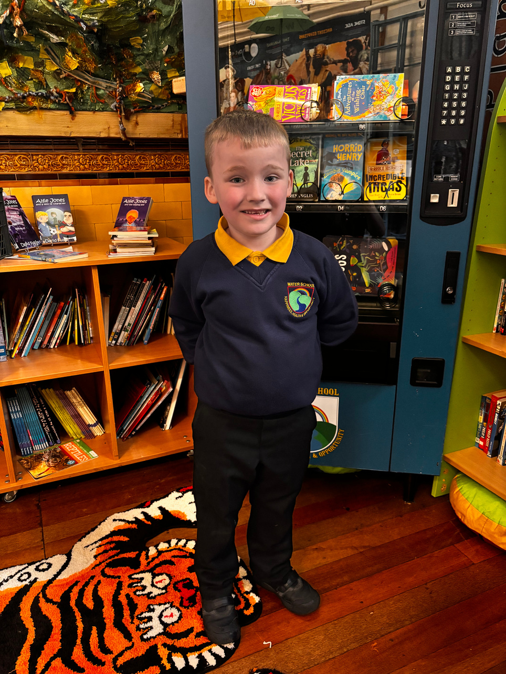
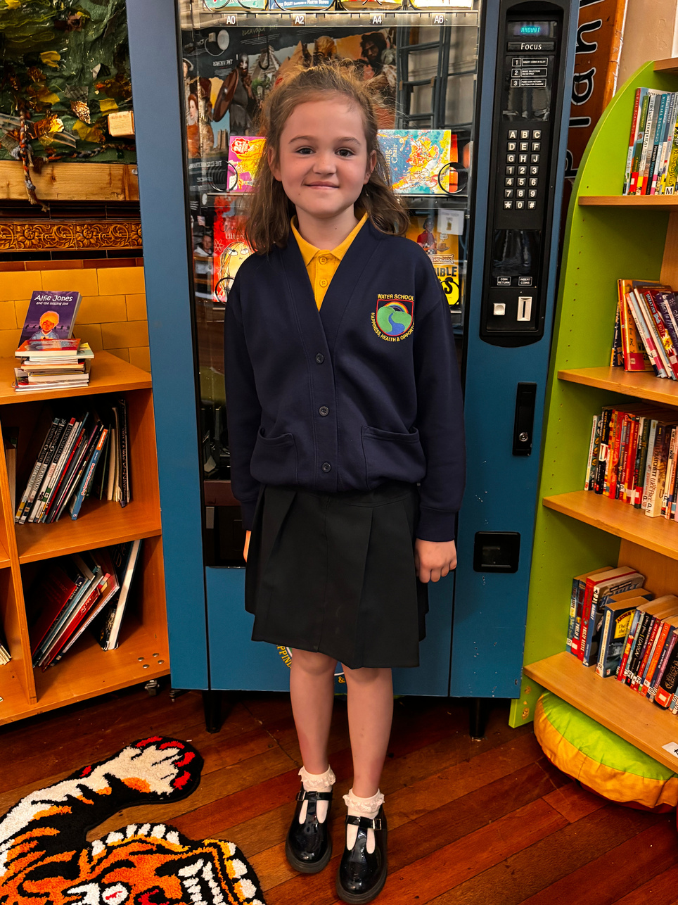
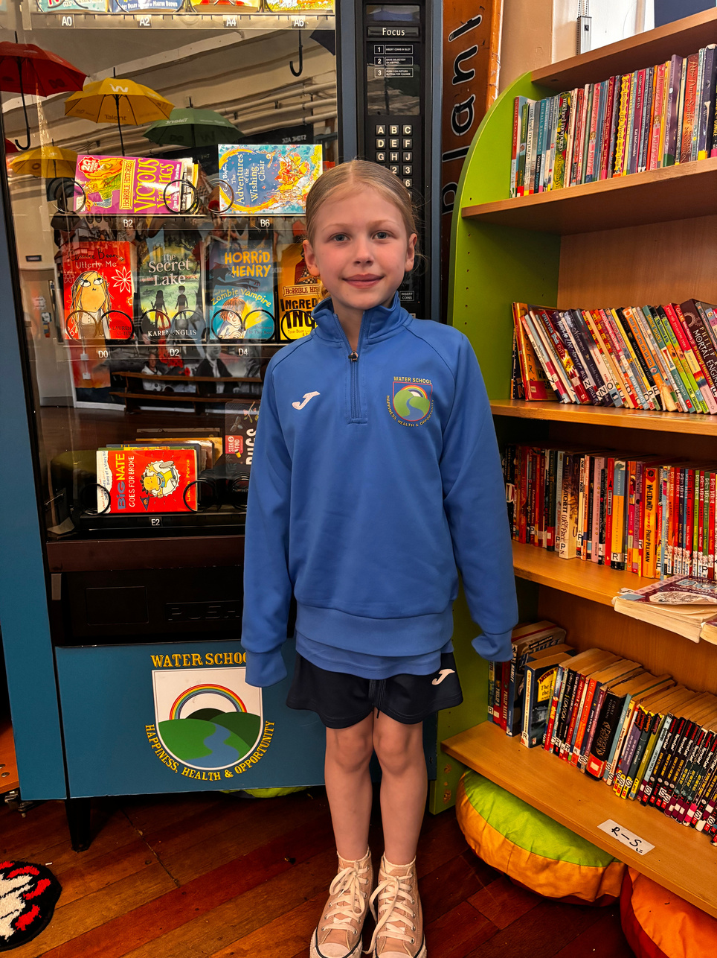
)
)
Children are asked to wear;
· Navy blue sweatshirt, jumper or cardigan
·Yellow polo shirt
·Black or navy blue trousers, skirt or pinafore (no tracksuit bottoms)
·Blue or yellow gingham dresses
·Plain dark or whiter socks or dark tights.
All uniform should have their name clearly written or sewed into it.
Plain black shoes (trainers which are not fully black are not permitted)
We also have our own Water Primary School PE kit. The children will wear this kit for the whole day on their PE day as well as Friday’s. The P.E. kit and uniform is available from LPES.
)
)
)
)
)
)
)
)
)
)
)
)
)
)
)
)

Slide 22
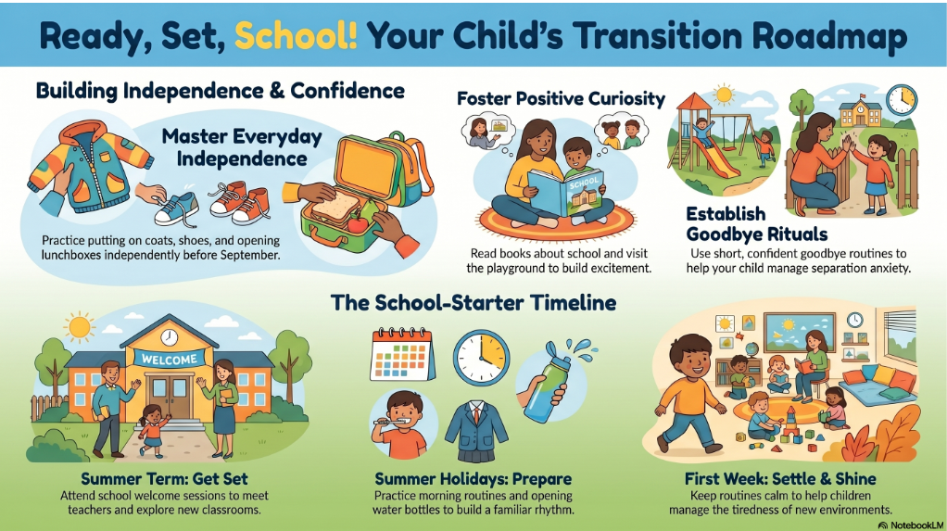
)
)
How can you help?
)
)
)
)
)
)
)
)
)
)
)
)
)
)
)
)

Slide 23
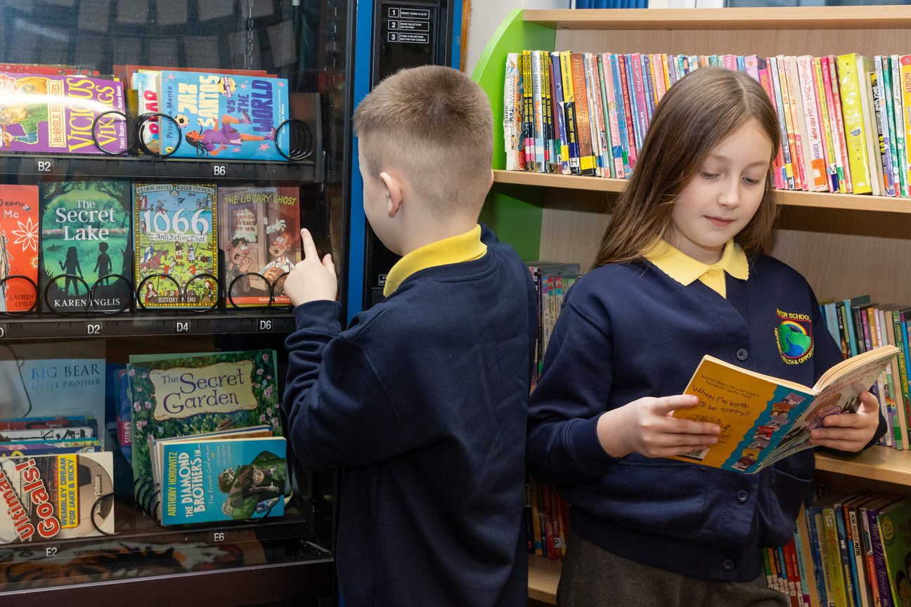
)
)
PUPIL PREMIUM
)
)
)
If your child qualifies for free school meals and you register them, the school receives extra funding called Pupil Premium.
This funding helps us provide additional support, resources, and opportunities, and may also help with things like uniform costs.
It can also mean you are eligible for free or reduced holiday clubs (HAF).
Please speak to Mrs Graham if you think you may be eligible—she will be happy to help.
)
)
)
)
)
)
)
)
)
)
)
)
)

Slide 24
)
)
GET INVOLVED WITH OUR SCHOOL
BECOME A GOVERNOR
JOIN THE PARENT-TEACHERS ASSOCIATION - FRIENDS OF WATER
)
)
)
As a parent governor, you help shape the school’s vision and direction and ensure leaders are doing their job well.
You bring an important parent perspective to decisions and discussions.
Parent governors are elected by other parents, and anyone can put themselves forward.
)
)
)
)
)
)
)
)
)
)
)
We help organise fundraising events throughout the year, such as discos, fairs, and competitions.
The money raised helps provide extra opportunities and experiences for our children.
)
)

Slide 25


Slide 26
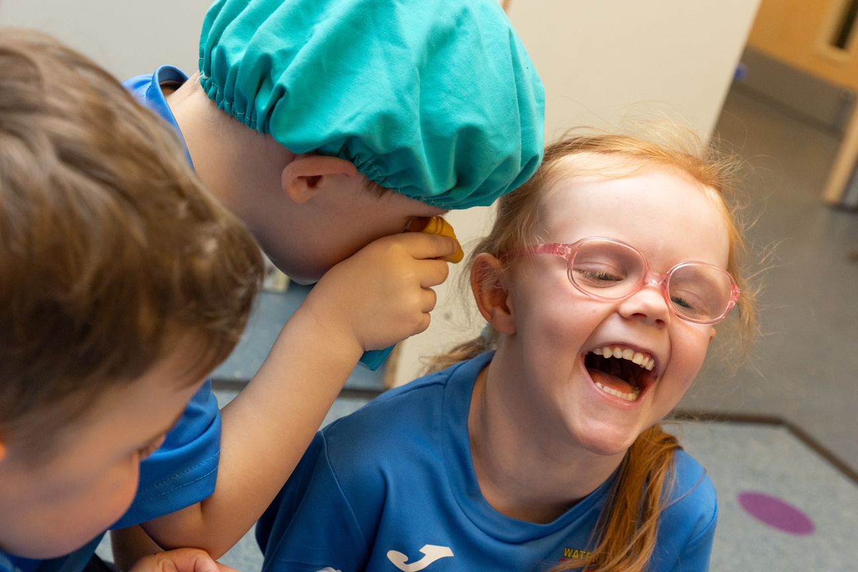
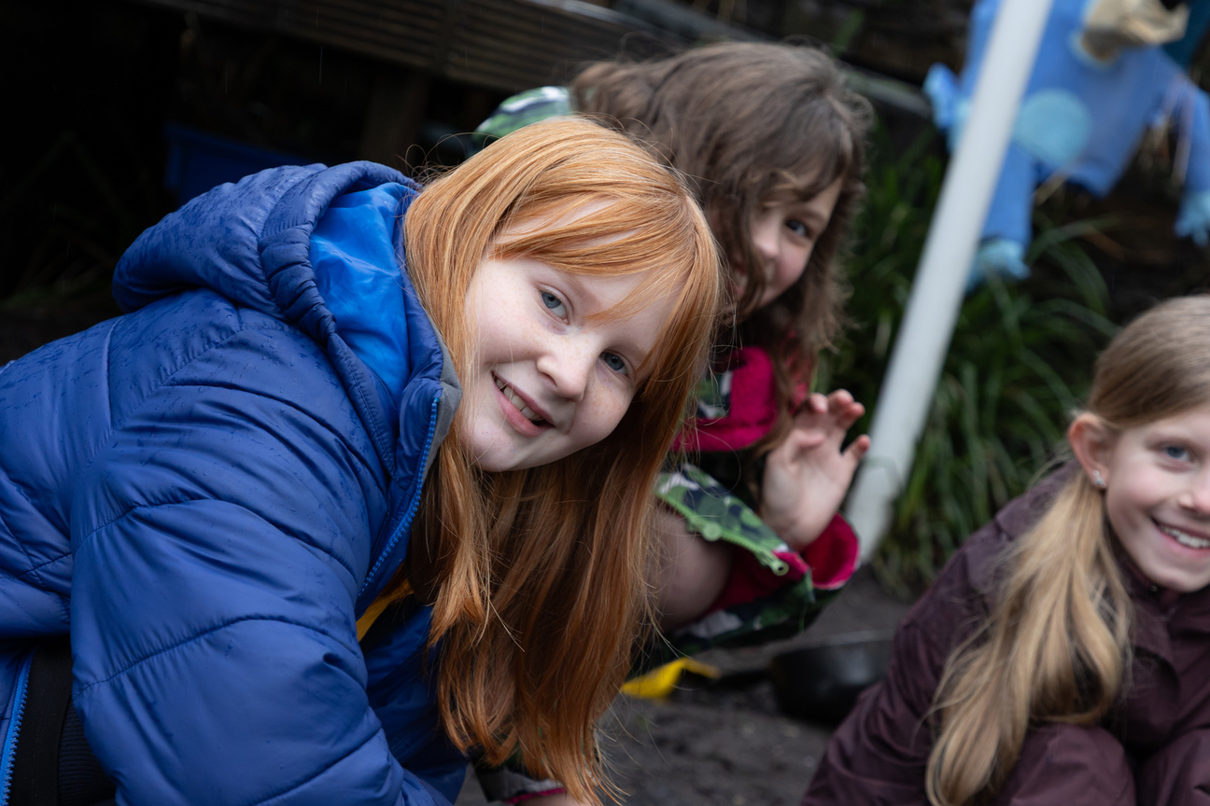
)
)
)
)
)
)
)
)
DATES FOR YOUR DIARY
  WEDNESDAY 1ST JULY - TRANSITION MORNING 9:10 - 10:10 (ONE PARENT INVITED)
  TUESDAY 7TH JULY - 9:05 - 11:30 TRANSITION MORNING (CHILDREN ONLY)
  17TH JULY - FAMILY FOREST SESSION 9:15 A.M. -11:00 A.M (APPROX)
)
)
)
)
)
)
)
)
)
)

Slide 27


)
)
)
)
)
)
)
)
)
)
)
)
)
)
)
)
)
)

