Slide 1

Day 1
Friday

Slide 2
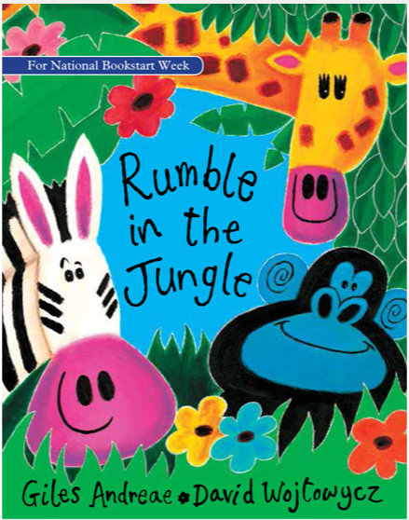
Rumble in the Jungle
https://www.booktrust.org.uk/books-andreading/have-somefun/storybooks-andgames/rumble-in-thejungle/
Read along with your adult with the sound on, or mute the sound and read the story/poem out loud to your adult.
Choose your favourite animal and try and re-read that verse.
Create actions to some of the words to help you remember, e.g. big (wide open arms).
Why is it your favourite animal in the book? Use words or phrases from the text to help you practise some sentences.

Slide 3
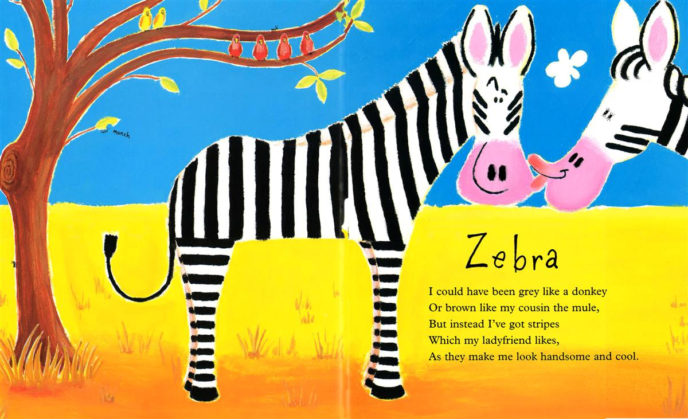
Write sentences to describe your favourite animal from the book. Use words from the text and the word ‘and’, e.g. I like the gorilla because he is big, black and hairy. He is ferocious and scary. He makes me laugh when he wallops his chest.
Check your sentences for capital letters at the start of sentences, full stops at the end, the use of ‘and’ and the capital letter for the tricky word ‘I’.

Slide 4
Day 2
Monday

Slide 5
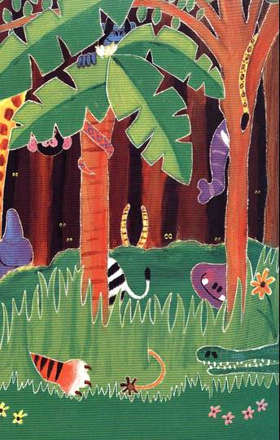
Read Rumble in the Jungle encouraging your child to join in with the verses.
https://www.booktrust.org.uk/books-andreading/have-somefun/storybooks-andgames/rumble-in-thejungle/
Write a short list of animals who live in the jungle, from those you have heard about in the book. Try and spell the animal names independently without peeking in the book - remember to use your phonic knowledge.

Slide 6
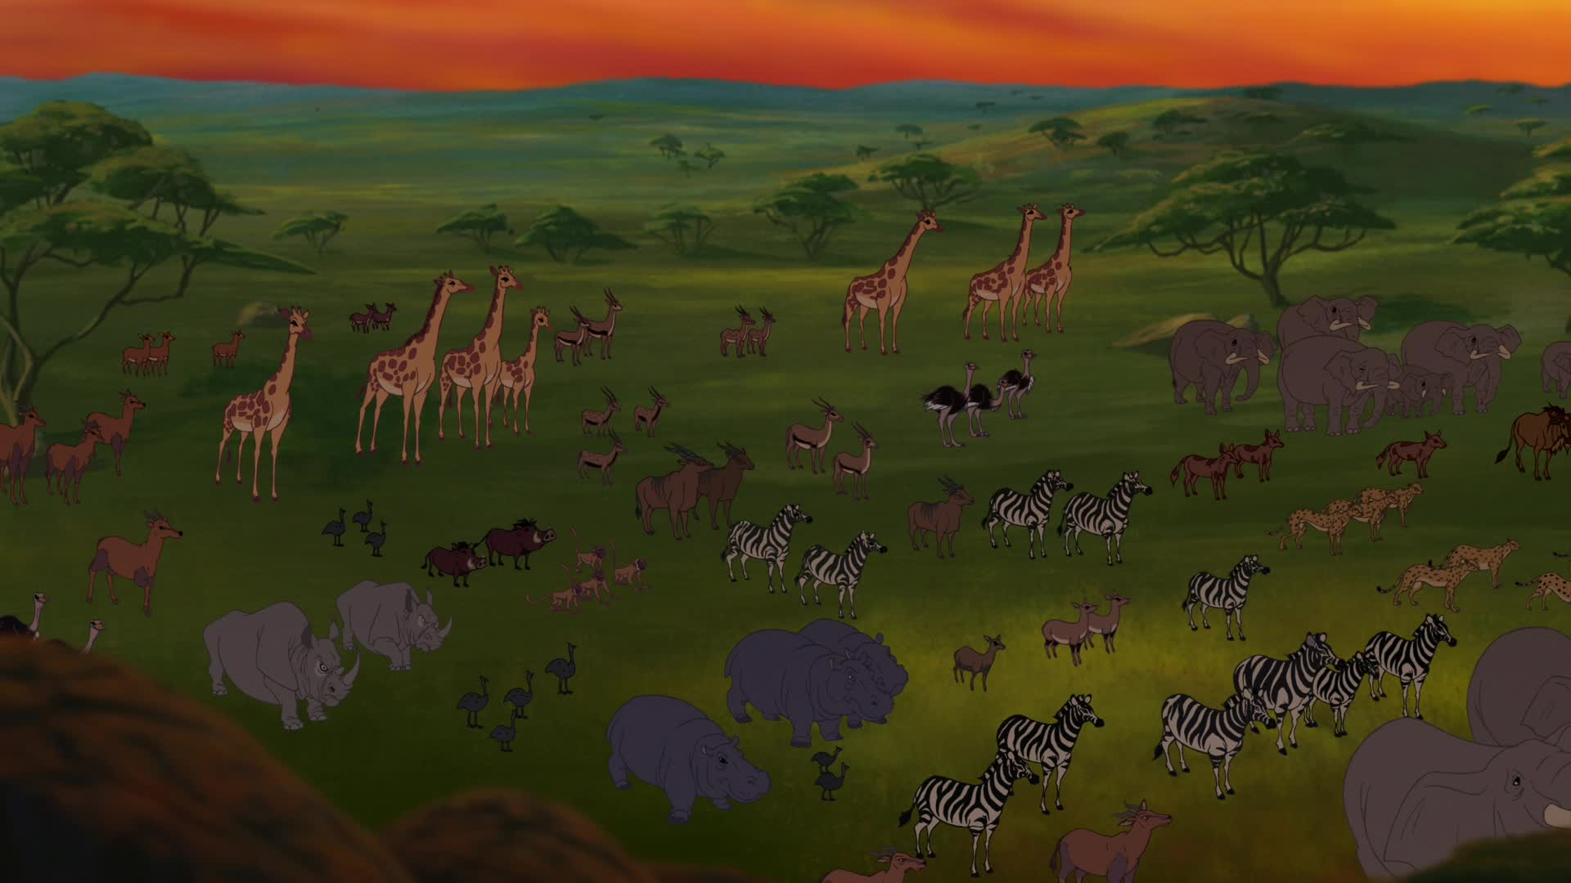
Watch the opening scene of the film The Lion King (up to 2:58 mins): https://www.youtube.com/watch?v=Zn_qirpdBag
Watch again but this time pause to discuss the animals you can see. Talk about animals you perhaps have not seen before. Make a list of as many animals from the scene as you can. Try to spell the animal names by yourself using your phonic knowledge and clapping each of the syllables in the names, e.g. vulture (two claps), zebra (two claps), elephant (three claps) and hyena (three claps).

Slide 7
Day 3
Tuesday

Slide 8
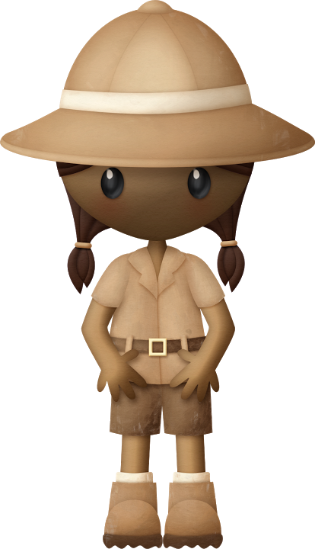
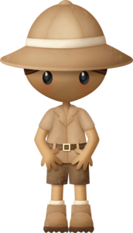
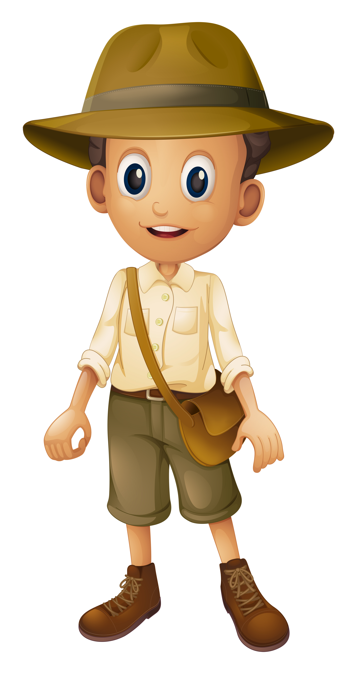
Watch and enjoy the clip on the Ten Jungle Animals for Kids. https://www.youtube.com/watch?v=qgK1WdYq_aw
(Note: this is an American clip so pronunciation of some animals may differ). Which animal did you find the most interesting and why?
I liked the… because…
Repeat watching the section of the clip where your favourite animal appears, pausing so that you can retell the facts that you have heard.
Ask children to become the expert on that animal and go and tell someone else in their household all about it.

Slide 9
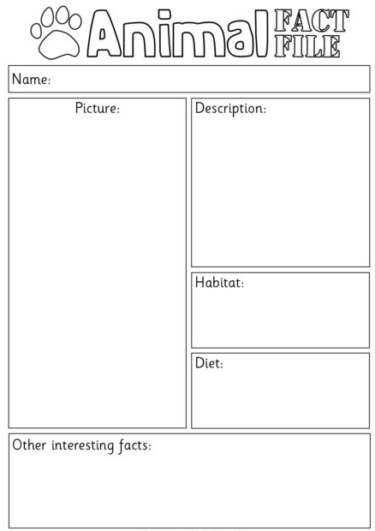
You now need to write a fact file on this animal. Make sure you write in sentences and include the information that you have heard, e.g. Jaguars - Jaguars are very big cats. They are about six feet long. They sleep in trees. They eat lots of other animals like deer, monkeys, snakes and fish.
Draw a picture of the animal and label it. Try to include a Did you know..? fact, such as: Did you know that jaguars love water and are great swimmers?
Check your work for capital letters, full stops, the use of the word ‘and’ and also question marks.

Slide 10
Day 4
Wednesday

Slide 11
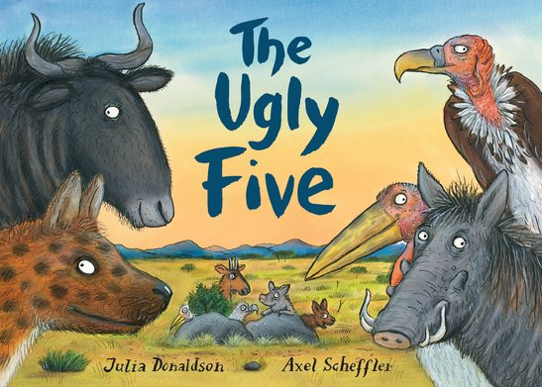
Read and enjoy The Ugly Five by Julia Donaldson and Axel Scheffler. https://www.youtube.com/watch?v=69K2IZ1A1ZU
Remember that these animals are described by the author as to why they think they are ugly. Can you spot words or phrases which describe each of the five to suggest why they might be thought of as ’ugly’? E.g. The spotted hyena has a spiky mane and spotty skin. He looks grotty and has a voice with a mixture of giggles and groans etc.
Orally tell an adult about each animal.

Slide 12
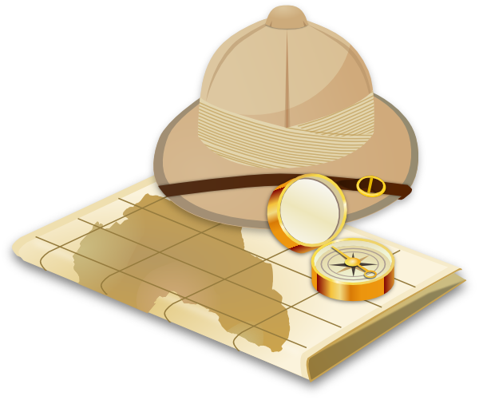
Imagine you are on a safari tour, viewing ‘The Ugly Five’ animals in the wild. Your challenge is to write a recount of what you have seen for your friends and family back home, including descriptions of the five animals.
Go back to each animal in turn and jot down key words or phrases which describe them.
Note: These do not have to be in full sentences today. The focus here is to gather vocabulary, e.g. The wildebeest’s spindly legs, gingery beard, big chunky chest, skinny behind etc.
Repeat with the other four animals.

Slide 13
Day 5
Thursday

Slide 14
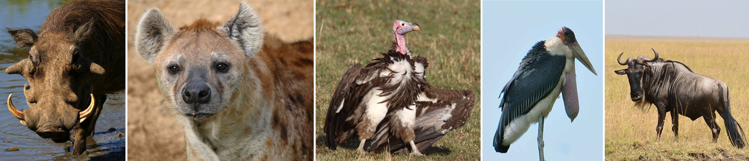
Re-read and enjoy The Ugly Five by Julia Donaldson and Axel Scheffler. https://www.youtube.com/watch?v=69K2IZ1A1ZU
Ask your child to use the prompts first, next, then, after and finally to describe which animal was seen in which order. Return back to the vocabulary collected yesterday on each of the animals. Begin to compose the recount using the above prompts and the vocabulary collected in the previous session. See next slide for an example.
Each animal can be described using the vocabulary collected.
Check your writing for correct spellings (using your phonics), capital letters for the start of sentences and for the word ‘I’, full stops and use of the words ‘and’ and ‘but.’

Slide 15
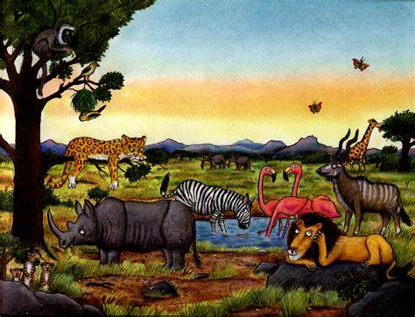
‘Yesterday I went on a safari tour to see The Ugly Five. First I saw the ugly wildebeest. It had spindly legs and a gingery beard. I could see its big chunky chest and its skinny behind. It looked really weird… Next I saw… Then I saw… After that I saw… Finally I saw…’
Challenge
Research the other animals at the back of the book, e.g. The Big Five. Write a recount pretending you saw these animals instead, after gathering some vocabulary about them.

